Slide 1
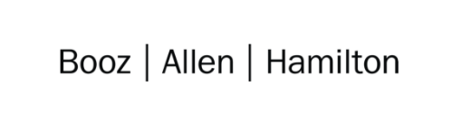

Cloud Excellence Presentation
Team 2
Members: Michael Chusuei, Bob Paolino, Heber Zambrano,
Quane’ Washington, Jared Dahlberg

Slide 2
TEAM 2:
Static Website Deployment using S3
Our Official Project for the Booz Allen Cloud Excellence Program
www.webagesolutions.com|1.877.517.6540

Slide 3





INTRODUCTIONS
MICHAEL CHUSUEI Cloud Engineer
Booz Allen Hamilton
BOB PAOLINO Cloud Engineer
Booz Allen Hamilton
HEBER ZAMBRANO Cloud Engineer
Booz Allen Hamilton
QUANE’ WASHINGTON Cloud Engineer
Booz Allen Hamilton
JARED DAHLBERG Cloud Engineer
Booz Allen Hamilton

Slide 4
Project
Introductions
Project Overview
Architecture and Design
Tools and Technologies Used
Challenges and Issues
Demo
What We Have Learned
What We Would Add
Questions
Deploying a Static Website to AWS Using S3 and CloudFront
www.webagesolutions.com|1.877.517.6540

Slide 5
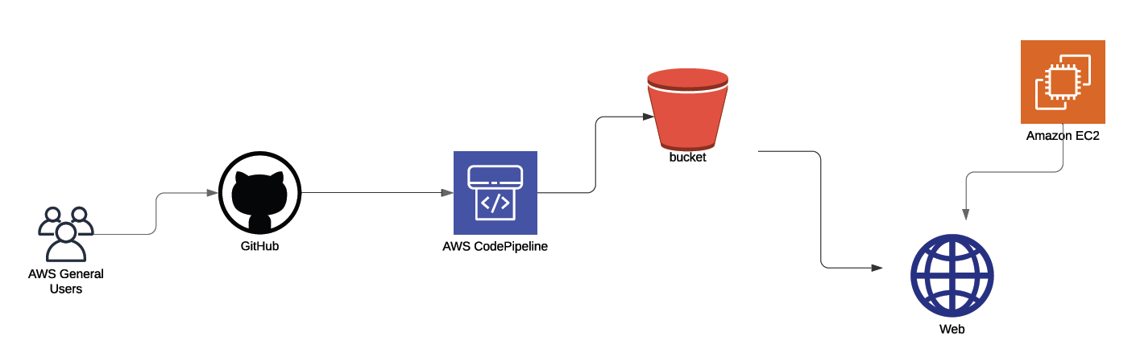
Architecture and Design - Version 1

Slide 6
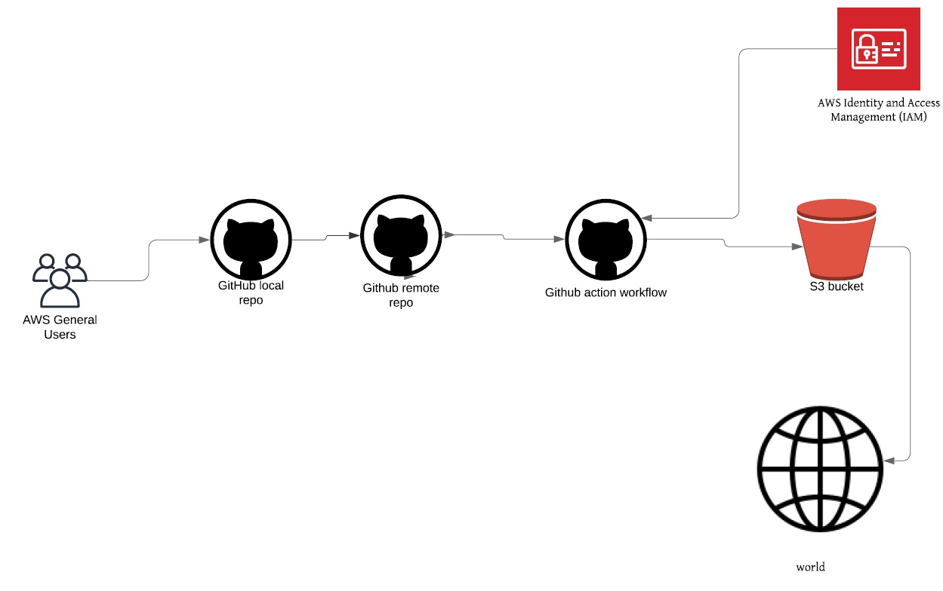
Architecture and Design - Version 2

Slide 7
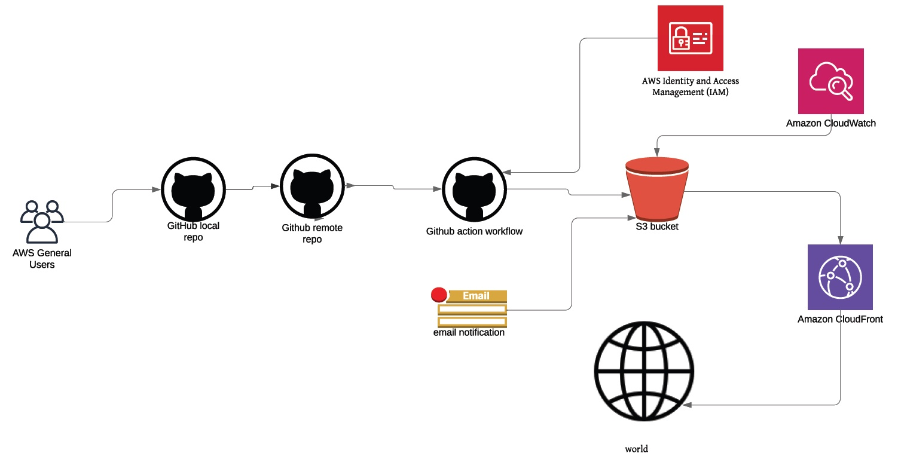
Architecture and Design - Version 3

Slide 8
Tools and Technologies Used
AWS S3
AWS CodePipeline
AWS CloudWatch
AWS IAM
AWS CloudFront
GitHub
Visual Code Studio
Former2
Final Product – V3
AWS S3
AWS CloudWatch
AWS IAM
AWS CloudFront
GitHub
Former2

Slide 9
Challenges and Issues
Creating YAML script is hard
Lots of troubleshooting when adding/changing services
Issues with getting S3 to read our GitHub repository
Trouble getting CloudFront to work with S3
Trouble creating CloudFormation template

Slide 10
Demo

Slide 11
What We Have Learned
How to attach code to AWS services
How to implement certain notifications to monitor our architecture
How to connect AWS IAM to GitHub
How to give and restrict access to buckets and users
How to make buckets public and turn public read access off for security purposes
How to simplify, modify, and add to architecture

Slide 12
Future State - What we would add
Load balancers
VPCs
Route 53 – creating a real domain name
CloudTrail – monitor API calls
More CloudWatch metrics

Slide 13
Questions?

Slide 14
Fin
Thank you!

